Slide 1
Lab 3 Calling C Programs using Shell Scripts
CSC – 320 Operating System
Engr. Rahemeen Khan
Operating System

Slide 2
Find command:
Find all the files whose name is file.txt and contains both capital and small letters in current working directory.
Syntax:
find options starting/path expression
Examples:
$ find . -iname file.txt
// Finds all files meeting described criteria and displays their paths
// The -iname specifies a file name search pattern
$ find . -iname “*.c”

Slide 3
Grep Command :
It searches one or more files for lines matching a given regular expression. Matching lines are output, while non-matching lines are discarded. grep’s syntax requires at least a regular expression to search for, which is followed by the name of a text file (or files) to be searched.
Syntax:
grep string expression
Examples:
$ grep int file.c // Finds all lines that contains the expression int
$ grep “int main” file.c // Use double quotes to find the exact word or sentence

Slide 4
sort command:
The sort command lets you sort the lines of text files according to predetermined criteria. The default setting is ascending (from A to Z) according to the ASCII default setting values of the first few characters of each line. For example, the character code of “Ä” is 143, so that character ends up far beyond “Z” with its character code of 91. Even the lowercase latter “a” is considered “greater than” the uppercase letter “Z”.
Syntax:
sort expression
Examples:
$ sort filename.txt // Sorts the content within the file and displays output on screen
$ sort filename.txt > sorted.txt // Sorts the content within the file and writes the output in sorted.txt
$ sort filename.txt >> sorted.txt // Sorts the content within the file and appends the output in sorted.txt
sort -r filename.txt //sorts the input file in reverse order i.e. descending order by default.

Slide 5
Variables :
A variable is nothing more than a pointer to the actual data. The shell enables you to create, assign, and delete variables.
The reason you cannot use other characters such as !, *, or - is that these characters have a special meaning for the shell.
Syntax:
variable_name=variable_value
Examples:
NAME="Zara Ali“
The above example defines the variable NAME and assigns the value "Zara Ali" to it. Variables of this type are called scalar variables. A scalar variable can hold only one value at a time.

Slide 6
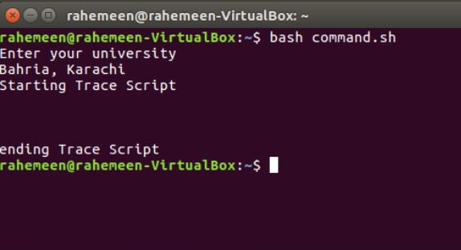
Using Different Linux Commands in Shell Scripts
#!/bin/bash
# This script runs various Linux commands
echo "Enter Your university"
read var1
echo "Starting Trace Script"
echo "Tracing Events" > tracefile.txt
echo
date >> tracefile.txt
echo
echo "I belong to $var1 " >> tracefile.txt
echo
echo "Ending Trace Script"

Slide 7
Loops in C Language
In general, loops are used when a block of code needs to be executed several number of times. The C programming language provides three types of structures to handle looping requirements, which are the for, while and do-while loops.
For | While | Do – while
#include <stdio.h> int main () { /* for loop execution */ for( int a = 0; a < 20; a++ ) { printf("value of a: %d \n", a); } return 0; } | #include <stdio.h> int main () { /* local variable definition */ int a = 0; /* while loop execution */ while( a < 20 ) { printf("value of a: %d \n", a); a++; // Same as a = a + 1 } return 0; } | #include <stdio.h> int main () { /* local variable definition */ int a = 0; /* do loop execution */ do { printf("value of a: %d \n", a); a = a + 1; // Same as a++ } while( a < 20 ); return 0; }

Slide 8
Calling C Programs from Shell Scripts
#!/bin/bash
# Compiling and calling the C programs from shell scripts
echo This script compiles and runs the Hello World program using a single script
# Compiling the C program source code
gcc hello.c -o hello
# Running the C program output file
./hello

Slide 9
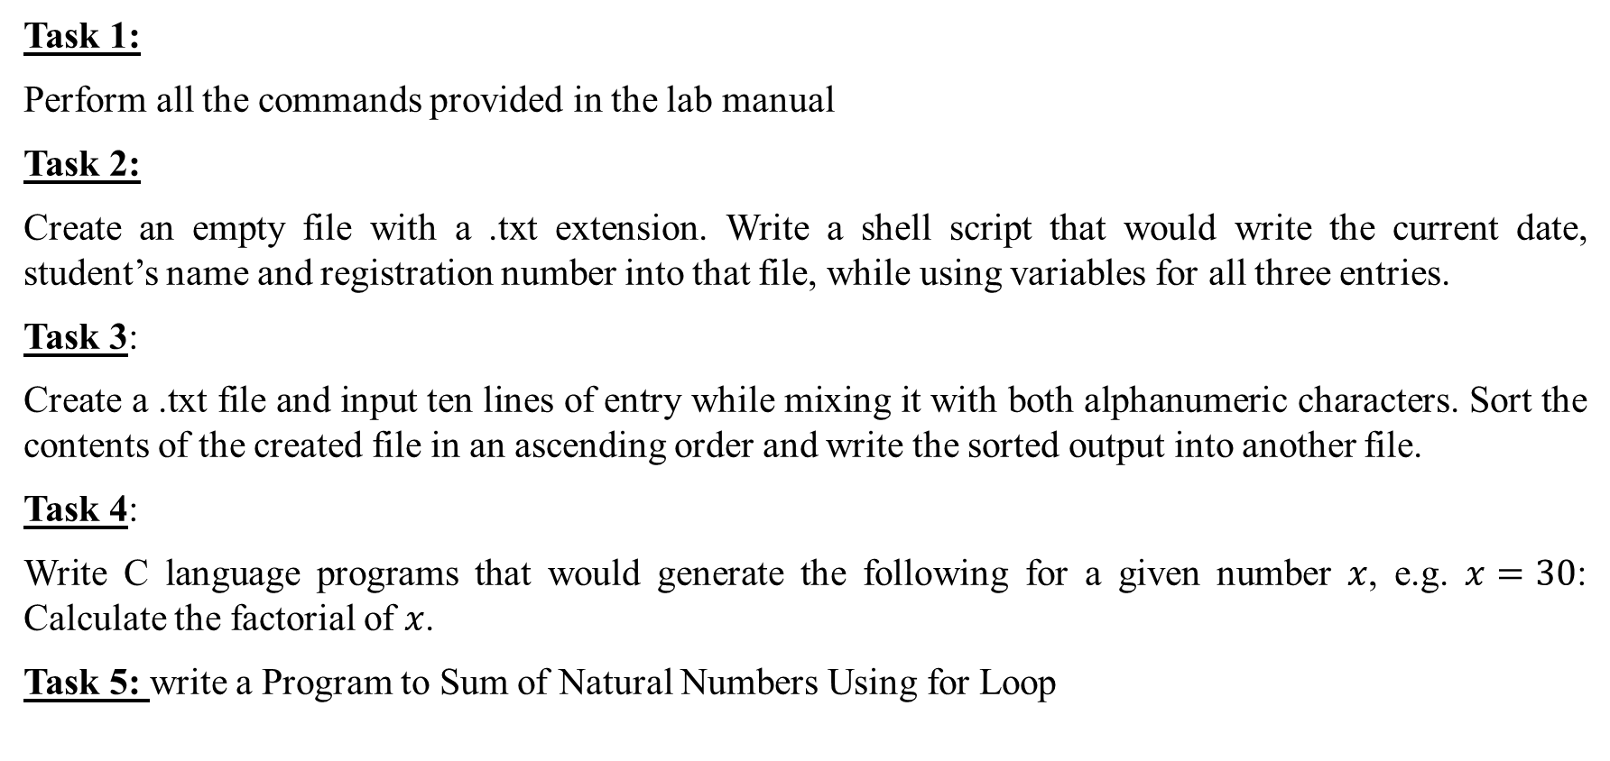
Lab Exercise
Task 1:
Perform all the commands provided in the lab manual
Task 2:
Create an empty file with a .txt extension. Write a shell script that would write the current date, student’s name and registration number into that file, while using variables for all three entries.
Task 3:
Create a .txt file and input ten lines of entry while mixing it with both alphanumeric characters. Sort the contents of the created file in an ascending order and write the sorted output into another file.
Task 4:
Write C language programs that would generate the following for a given number $x$, e.g. $x=30$: Calculate the factorial of $x$.
Task 5: write a Program to Sum of Natural Numbers Using for Loop

